Slide 1
UI AUTOMATION USING IMAGE PROCESSING
AN AUTOMATION APPROACH WITH HUMAN PERCEPTION
KARUNAKAR GONNABATHULA
SPOC : TRUPTI MALI
MENTOR : MOHIT BANSAL
Notes:
Direct & Indirect?

Slide 2

Approach
Why Machine Learning and Deep Learning ?
USECASE - I
BRAIN OF OUR PROCESS AND ITS FUNCTIONS
ARCHITECTURE
USECASE - II
LIBRARIES
SCALABILITY

Slide 3
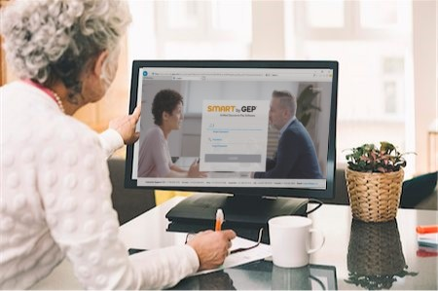
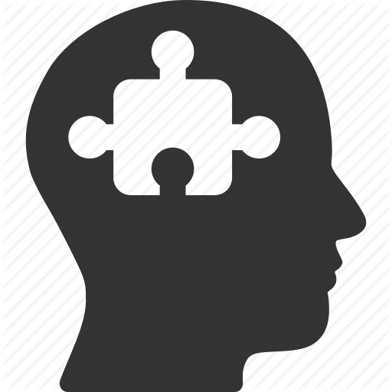
Approach
Human Perception
What does a human do to perform actions on UI?
SEE
CAPTURE
PROCESS
DEFINE ACTIONS

Slide 4
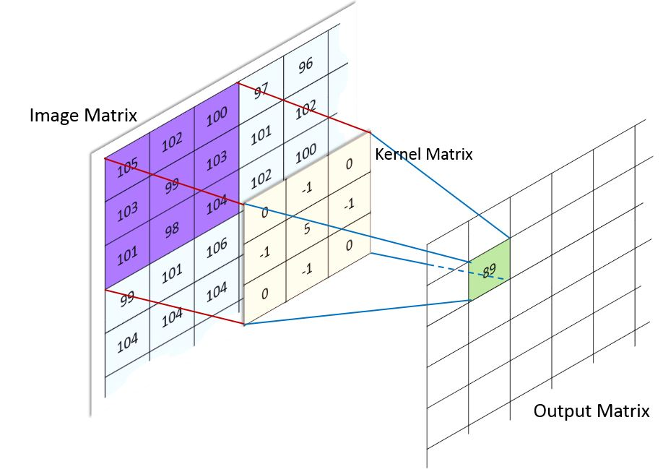
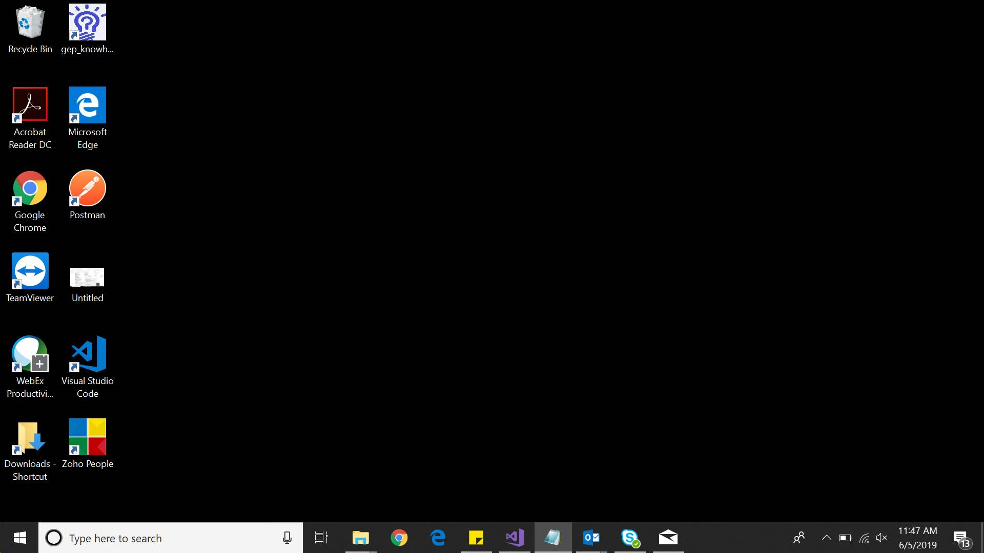

TRAIL 1
Template matching by image processing
Approach
Human Perception

Slide 5
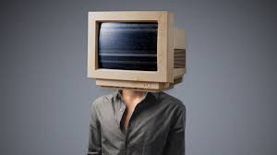

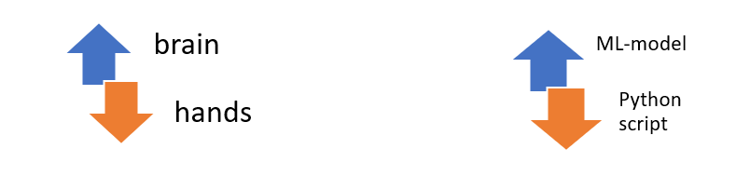
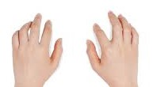
Why Machine Learning and Deep Learning ?
We require a unit that can take decisions, identify the objects from an image.
Human uses his brain to process, then feed the parameters to analyze it.
Similarly to this, we use machine learning and feed input parameters from the image processing and let it learn to make the decisions later.
Our trained model acts as brain to us.

Slide 6
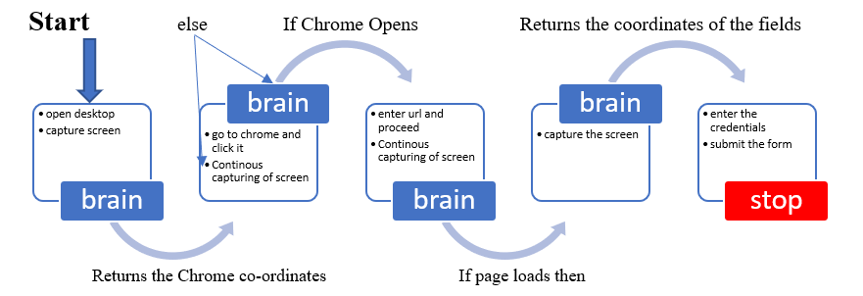
USECASE - I
LOGIN
TO SMART ON
CHROME

Slide 7

BRAIN OF THE PROCESS AND IT’S FUNCTIONS
OBJECT-DETECTION MODULE
CLASSIFIER MODULE
STACK
OF
TRAINED
DETECTORS
STACK
OF
TRAINED CLASSIFIRES
SCRIPTING ML MODULE TO COMMUNICATE TO TRAINED MODELS AND PYTHON SCRIPTS
PYTHON SCRIPT

Slide 8
DEMO

Slide 9


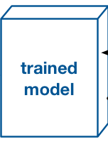
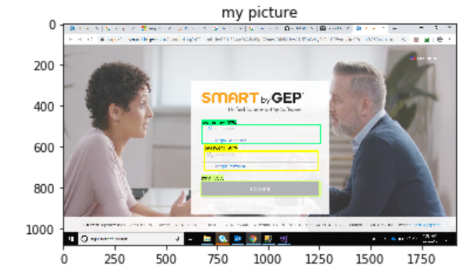
BRAIN OF THE PROCESS AND IT’S FUNCTIONS (Contd..)
IN GENERAL: -
Co-ordinates of detected objects
OBJECT
DETECTION
MODULE
Username: (969 , 539),99%
Password: (964 , 668) ,96%
Login : (969 , 807),99%
OUR CASE: -
DOCKER

Slide 10
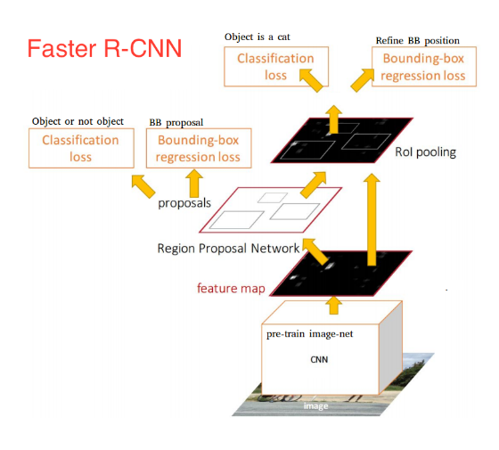
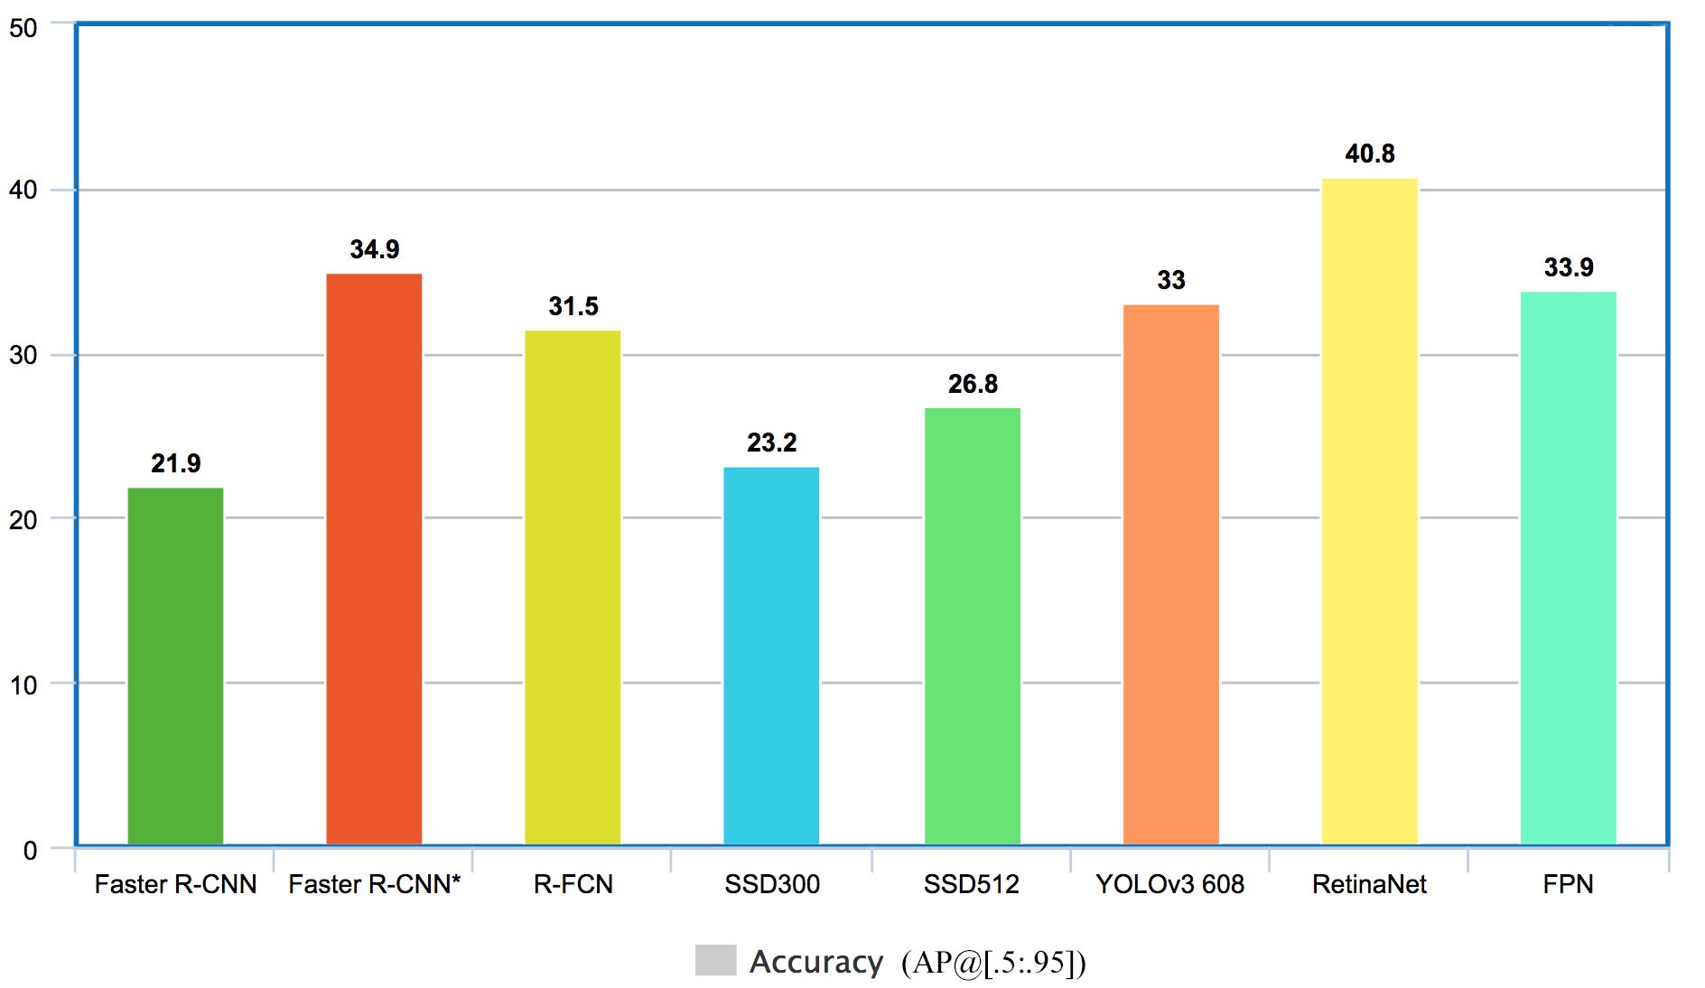
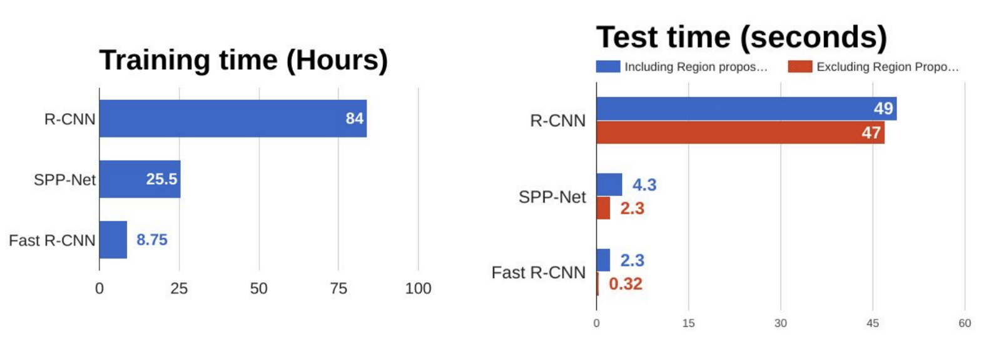
BRAIN OF THE PROCESS AND IT’S FUNCTIONS (Contd..)
BLACK BOX
IN
OBJECT
DETECTION
MODULE

Slide 11
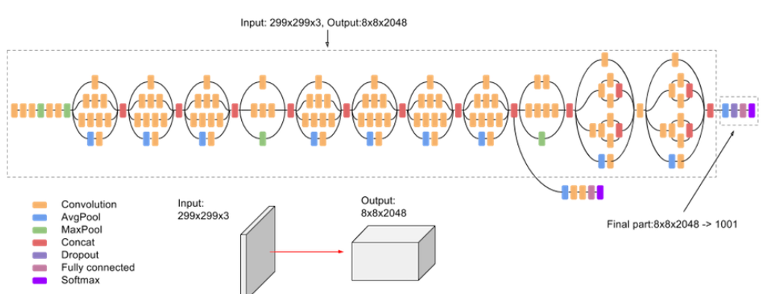
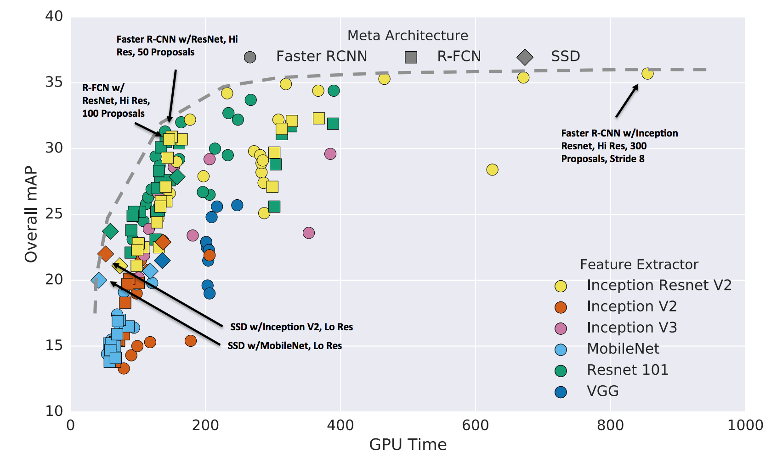
BRAIN OF THE PROCESS AND IT’S FUNCTIONS (Contd..)
BLACK BOX
IN
CLASSIFIER
MODULE

Slide 12
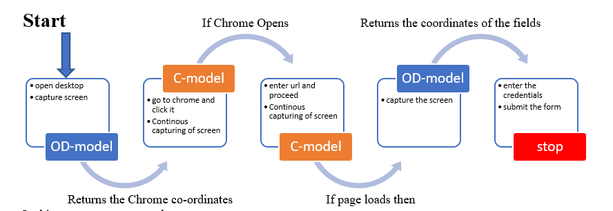

BRAIN OF THE PROCESS AND IT’S FUNCTIONS (Contd..)
ANALYSIS OF USE CASE - I
OD-MODEL : Object Detection model
C-MODEL : Classifier model

Slide 13
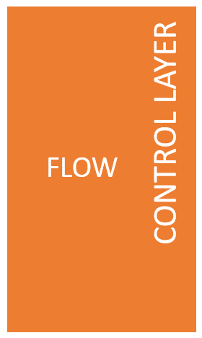
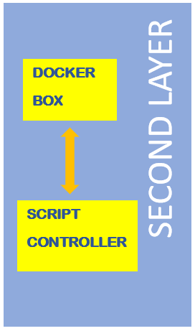
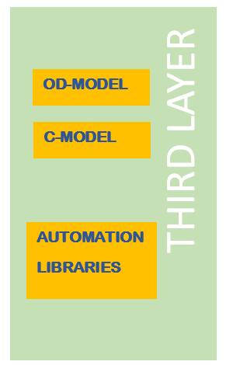
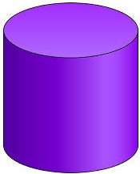
Synchronous Screen Replicating
LAYERED
ARCHITECHTURE
Trained
detectors
Trained
classifiers
ASSETS
ASSETS
Keyboard
functions
ASSETS

Slide 14
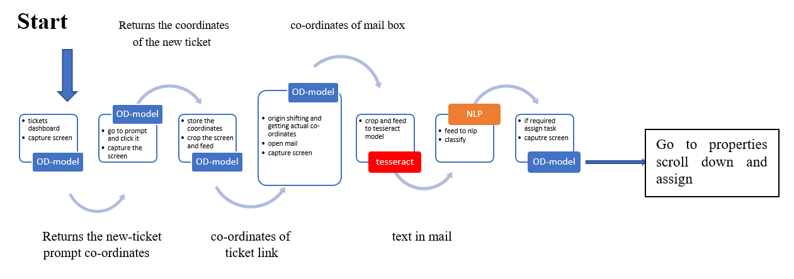
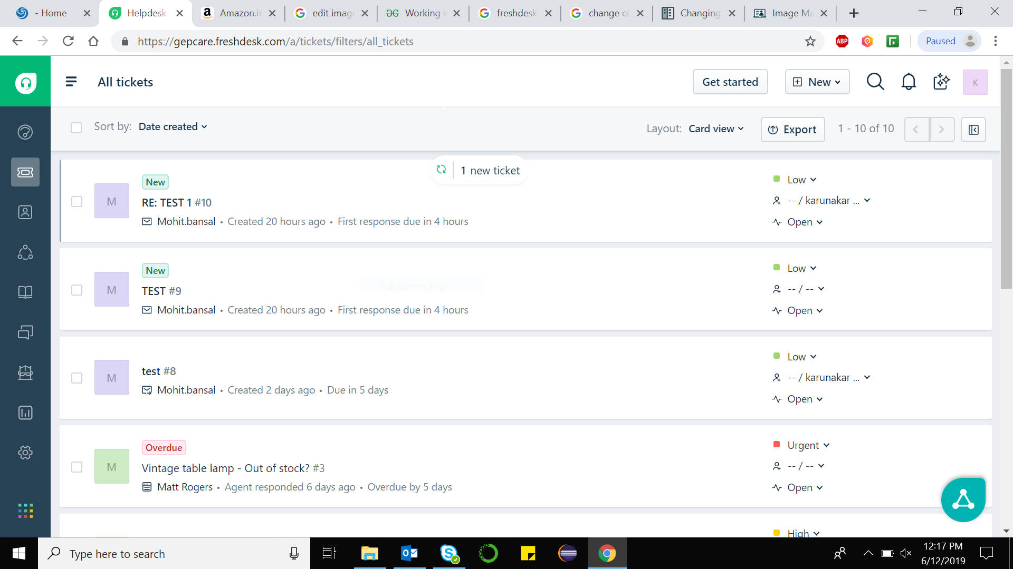
USECASE - II
MONITORING A
HELPDESK AND
TAKE ACTIONS ON
NEW TICKETS

Slide 15
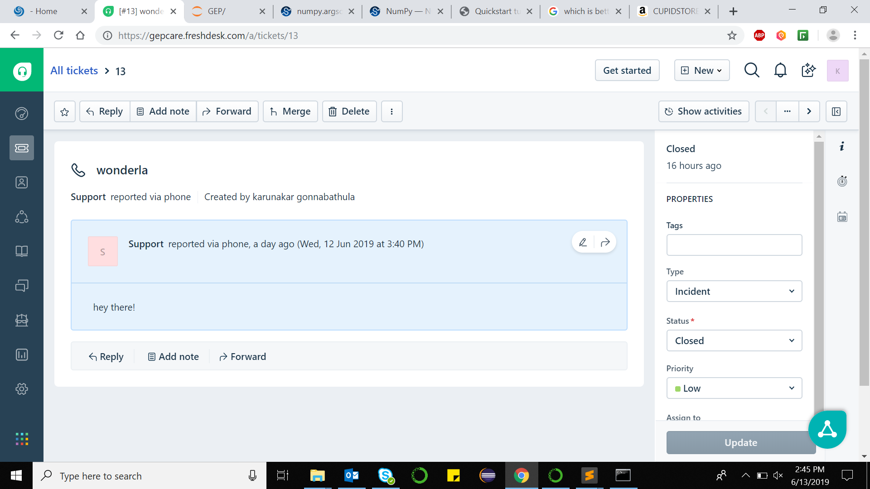

Crop and feed
Migrate back to original co-ordinate system
USE CASE – II (Contd..)
Pytesseract
Text extractor
Hey There ! Text in mail.

Slide 16
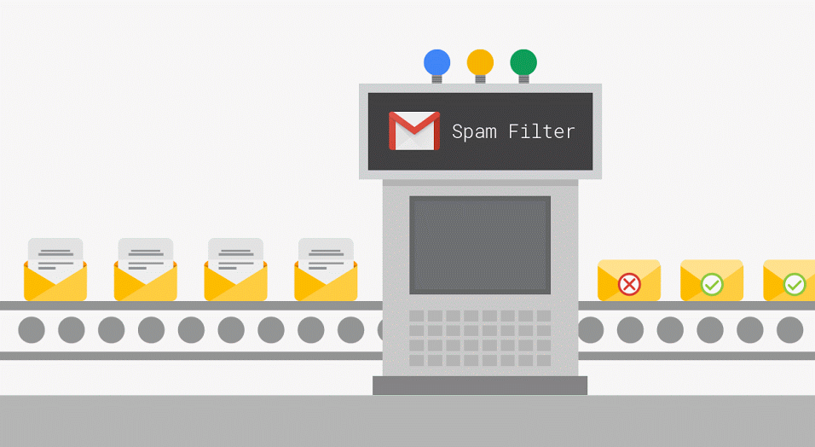

USE CASE – II (Contd..)
Hey There ! Text in mail.
NLP
NLP trained
Weight
model
IF NOT SPAM
ASSIGN THE TASK

Slide 17
DEMO

Slide 18
TensorFlow Apache License 2.0
Keras Apache License 2.0
Pillow Historical Permission Notice and Disclaimer (HPND)
Cython Apache License 2.0
Pandas BSD
Open Cv MIT License (MIT)
NLTK Apache Software License
Pyauotgui BSD License (BSD)
Keyboard MIT License (MIT)
NumPy OSI Approved (BSD)
Protobuf 3-Clause BSD License
Matplotlib Python Software Foundation License (PSF)
Sklearn OSI Approved (BSD)
Pytessaract GPLv3
USED
LIBRARIES

Slide 19
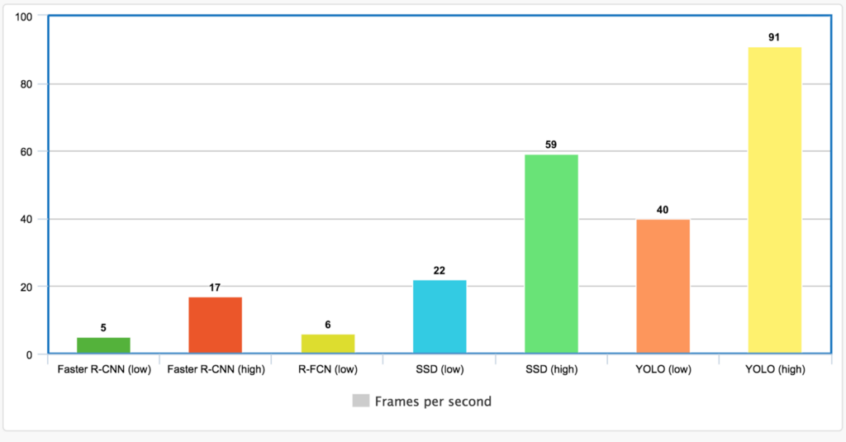
ACCURACY
CASE – I: Choosing high accuracy models
SCALABILITY
IN ACCURACY
Leaving Back the Process Time
Requires High Process GPU’s

Slide 20
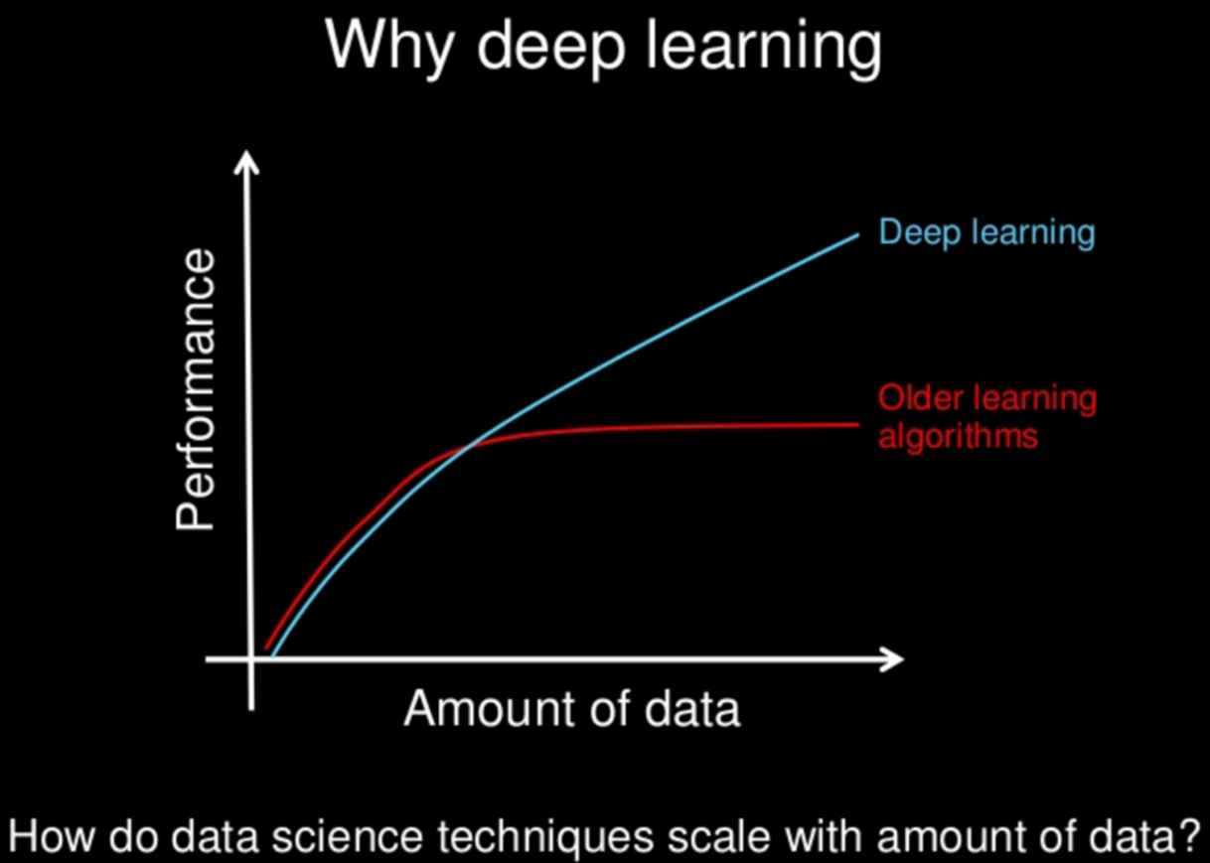
ACCURACY
CASE – I: Amount of Training data
SCALABILITY
IN ACCURACY
Eliminates Environment specific training

Slide 21
FILE SIZES
CASE – I I : Lesser input parametric Models
CASE – I : Lesser stacked models in MODULES
SCALABILITY
IN SIZE
Eliminate environment specific
Reduce Inference graph sizes

Slide 22

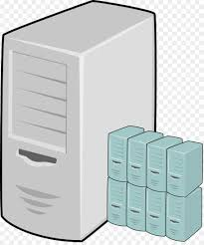
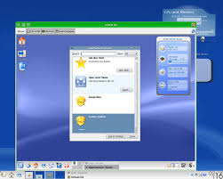
DEPLOYMENT ( PARTITIONING LAYERS OF ARCHITHECTURE)
CASE - I
ASSETS
CLIENT MACHINE
SCALABILITY
IN DEPLOYMENT
CASE - II
ASSETS
VIRTUAL SERVER MACHINE
CLIENT MACHINE
CASE – III
ASSETS
CLIENT MACHINE

Slide 23
TIME
SOLUTION: -
Pre load the dockers
DOCKER
REDUCE THE LOADING TIME
3/4th Time
1/4th Time
SCALABILITY
IN TIME TAKEN
DOCKER
Replicate
DOCKER
PRE LOAD THE MODEL
ACCORDING TO FLOW

Slide 24
SCOPE

Slide 25
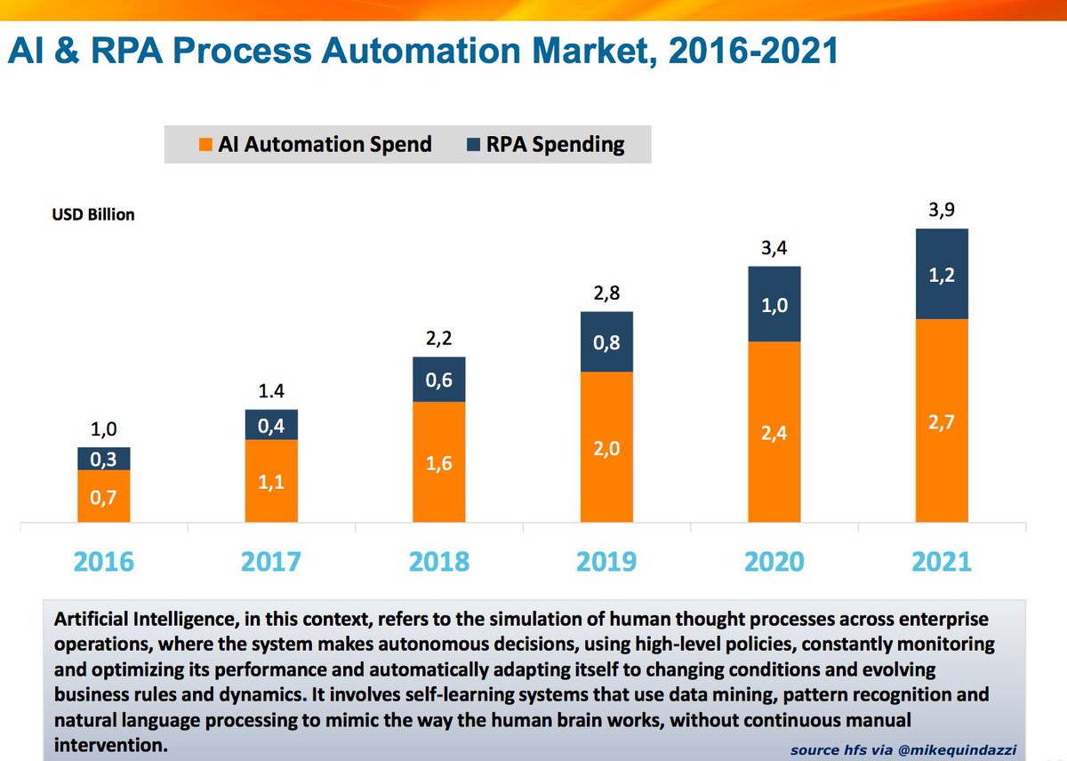
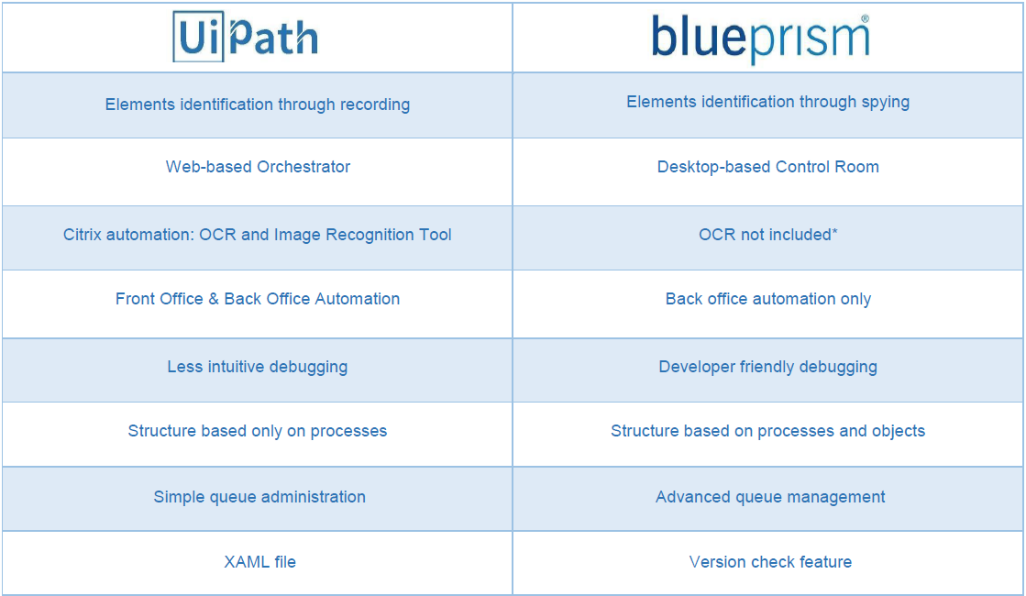
Scope in Advancement

Slide 26
Questions & Answers

Slide 27
Thank You

